Slide 1
IT Security and Penetration Testing
Chapter 17
Linux Vulnerabilities

Slide 2
Objectives
Identify UNIX-based operating systems
Identify Linux operating systems
Identify vulnerabilities from default installation
Identify various vulnerabilities in Linux and UNIX-based utilities
Computer Security and Penetration Testing

Slide 3
Linux Vulnerabilities
Linux
  Second most widely used Intel-based microcomputer operating system
  Derived from UNIX by an engineering student from Finland named Linus Torvalds in 1991
UNIX
  Ken Thompson and Dennis Ritchie at Bell Labs developed this general-purpose operating system in 1969
Computer Security and Penetration Testing

Slide 4
UNIX-Based Operating Systems
Some of the most popular UNIX-based operating systems are
  BSD, HP-UNIX, AIX, and SCO Unix
SunOS and Solaris arose, mostly, from BSD code
Most of them are proprietary and maintained by their respective hardware vendors
Computer Security and Penetration Testing

Slide 5
Linux Operating Systems
Linux source code is available free of cost
  And some Linux distributions (distros) are also free
Basic architecture and features of Linux are the same as those of the UNIX-based operating systems
Linux follows the open-development model
Distros use one of two different packages in their automated package installation technology
  Red Hat Package Manager (RPM)
  Debian packages (DEBs)
Linux is not fully secure in a default installation
Computer Security and Penetration Testing

Slide 6
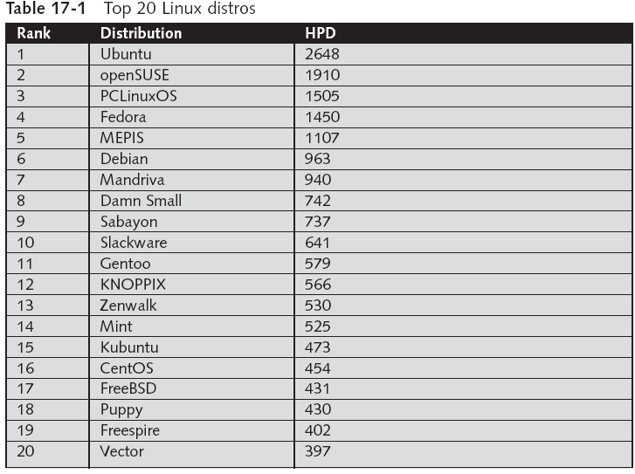
Computer Security and Penetration Testing

Slide 7
Vulnerabilities from Default Installation
Most services are off by default upon installation
  They must be configured to run
This is one of the main reasons that Linux/UNIX-based operating systems are considered safer than Windows
Computer Security and Penetration Testing

Slide 8
Basic Exploits
Basic hacks for a Linux system start with physical access
  The first security measure is to lock down physical access to your Linux servers
Even if you protect your operating system, it is still vulnerable to hacking attempts
  Set your computer to start only from the hard drive,
  Set a BIOS password
Computer Security and Penetration Testing

Slide 9
Login Passwords
Some Linux and UNIX-based operating systems store encrypted login passwords
  In a file called /etc/passwd
File also contains the logon names in the more vulnerable, cleartext format
Everybody can read this file, including hackers
Majority of UNIX password-cracking tools can decrypt the passwords stored in the passwd file
Computer Security and Penetration Testing

Slide 10
Login Passwords (continued)
Some UNIX and Linux distros store passwords
  In a file called /etc/shadow, which is readable only to root
root is the default and unchanging administrative user for UNIX/Linux systems
All the users of a Linux system are obliged to select strong passwords
  The password for root must be especially strong
Computer Security and Penetration Testing

Slide 11
Bad System Administration Practices
Root Account Mismanagement
  Hackers almost always first attempt to gain access to the root account
  Strong passwords are best for the root account
  Use root access only when you actually need root access
  Another vulnerability is leaving a system unattended
    After logging on with the root account
Computer Security and Penetration Testing

Slide 12
Bad System Administration Practices (continued)
Root Account Mismanagement (continued)
  An organization that grants special access to users or groups should not grant any root privileges to them
  A Linux system configured in a way that allows remote login is more vulnerable to hacking activities
Computer Security and Penetration Testing

Slide 13
Bad System Administration Practices (continued)
Default Account Mismanagement
  Some special accounts are created by default while installing a Linux operating system
  Default Linux accounts include adm, lp, halt, sync, news, uucp, operator, games, ftp, and gopher
  Some default groups, such as adm, lp, and popusers, are also present in the Linux operating system
  To delete an account, use the following syntax:
    userdel account_name
  Use the following syntax to delete a group:
    groupdel group_name
Computer Security and Penetration Testing

Slide 14
Bad System Administration Practices (continued)
File Export Mismanagement
  If you use the NFS, or Network File Sharing service, for exporting files
    Be aware that there is a risk to the integrity of data in the file
  Access to the /etc/exports file should be restricted to read-only
Console Program Access Mismanagement
  Console programs that could be exploited include shutdown, poweroff, reboot, and halt
Computer Security and Penetration Testing

Slide 15
Bad System Administration Practices (continued)
Resource Allocation Mismanagement
  If every user of a Linux system has unlimited access to resources
    Then malicious users can conduct denial-of-service attacks
  Apply resource limits to all users
    To do this, you use the /etc/security/limits.conf file
Computer Security and Penetration Testing

Slide 16
Bad System Administration Practices (continued)
su Command Mismanagement
  switch user (su) command
    Helps users of a Linux operating system temporarily switch the current privileges available to those of the root account
  Access to this command should be restricted
  The best administration practice is to use the sudo utility rather than the su command
Computer Security and Penetration Testing

Slide 17
Unnecessary Services
When you install the Ubuntu Linux operating system
  You will notice that various networking services are available including telnet, IMAP, POP3, and ftp
These services are highly vulnerable to unauthorized access
If you are not using the service, do not install it
Computer Security and Penetration Testing

Slide 18
Utility Vulnerabilities
Weaknesses within some utilities
  Allow hackers to breach the security of a Linux or UNIX-based operating systems
Computer Security and Penetration Testing

Slide 19
r Utilities Vulnerabilities
r utilities
  Permit users to access Linux and other UNIX-based operating systems from remote locations
rlogin utility lets a user connect to a remote host from the terminal of a local host
rsh utility is used to permit trusted users to execute commands on a local host from a remote host
r utilities use an insecure mechanism called rhosts
  Transmit data in the plain text form
Use SSH or some other secure protocol instead
Computer Security and Penetration Testing

Slide 20
Sendmail Vulnerabilities
sendmail daemon
  Sends e-mail messages by employing Simple Mail Transfer Protocol (SMTP)
sendmail open source version 8.13.5 and all similar commercial versions
  Have a vulnerability that lets remote hackers deliver commands on a target system
  Attackers can send malformed e-mail messages to that system
    And then carry out commands with root privileges on the target system
Computer Security and Penetration Testing

Slide 21
Telnet Vulnerabilities
Telnet
  Allows users to connect to a UNIX, Linux, or Windows computer from remote locations
  Sends data unencrypted over the network
Hackers take advantage of this service by using brute-force and dictionary attacks
  To connect to a target system
telnet must be disabled
  Use ssh instead
Computer Security and Penetration Testing

Slide 22
Trivial File Transfer Protocol (TFTP) Vulnerability
UNIX and Linux systems use Trivial File Transfer Protocol, or TFTP, to start diskless computers
TFTP
  Allows routers to get system configuration details without having to logon to a Linux system
  Does not require any type of authentication
Hackers can use these vulnerabilities to acquire unauthorized access
  To a Linux system that uses this service
Computer Security and Penetration Testing

Slide 23
groff Vulnerability
groff package
  Used in Red Hat Linux for document formatting
There is a buffer overflow vulnerability in the preprocessor of this package
  Prior to version 1.7.3
  Enables attackers to gain access rights to the lp account in the target system
Hackers need to invoke groff in the LPRng printer spooler
Computer Security and Penetration Testing

Slide 24
Printing Vulnerability
Printing security feature of Red Hat Linux 7.2 is vulnerable to attacks
  Permits remote users to print any file on a Red Hat Linux 7.2 system
    For which the lp account has the read permission
You can prevent hackers from using this vulnerability
  By updating the affected Ghostscript package
Computer Security and Penetration Testing

Slide 25
passwd Command Vulnerability
passwd command in shadow in Ubuntu 5.04 through 6.06 LTS
  When called with the -f, -g, or -s flag, does not check the return code of a setuid call
    Which might allow local users to gain root privileges if setuid fails in cases such as PAM failures or resource limits
Computer Security and Penetration Testing

Slide 26
sudo Vulnerability
Oldest sudo versions, before sudo version 1.6.4
  Had a functionality bug that allowed hackers to gain root privileges
These versions did not clear environment variables before sending warning e-mail messages
Hackers can pass parameters to the sudo package
  This activity may permit them to gain root access
Computer Security and Penetration Testing

Slide 27
mutt Buffer Overflow Vulnerability
mutt is a text-based e-mail client package
  That you can use in any Linux or UNIX-based operating system
mutt package version earlier than mutt-1.2.5.1
  Has a buffer overflow weakness that allows hackers to overwrite the data stored in the system memory
Attackers sometimes send e-mail messages with malformed content to the target system
  Permits these remote hackers to change the arbitrary bytes in the memory
Computer Security and Penetration Testing

Slide 28
The UseLogin Vulnerability of OpenSSH
SSH is a program that provides a secure connection to a distant, remote computer
OpenSSH directive UseLogin
  Used to maintain control of user login attempts by using the /usr/bin/login command
This directive is not enabled with the default installation of OpenSSH
Computer Security and Penetration Testing

Slide 29
The UseLogin Vulnerability of OpenSSH (continued)
Vulnerability allows remote hackers to gain root access to the Linux operating system
  When a user executes a command from a remote location
    OpenSSH drops root privileges and then executes the command
  In some situations, however, OpenSSH fails to drop root privileges
    Lets the hacker gain the root access to the system
Computer Security and Penetration Testing

Slide 30
wu-ftpd Exploits
wu-ftpd
  Ftp server that allows users to organize files on the server to perform ftp actions
When a user sends an ftp command, the wu-ftpd server allocates some area of the memory space
  Using the malloc() function, to process the command
In case of an error while processing a command
  The server does not allocate any section of the memory to that command request
  Stores this error information in a variable
Computer Security and Penetration Testing

Slide 31
wu-ftpd Exploits (continued)
For some specific file patterns
  wu-ftpd server fails to set the variable with the error information
Failure causes the server to attempt to allocate some memory for the process
Computer Security and Penetration Testing

Slide 32
GID Man Exploit
A buffer overflow occurs in the ultimate_source() function
  Of a few early versions of the GID man package
Hackers often use this buffer overflow to gain root access to a target system
To exploit this vulnerability
  Hackers generate man pages that contain filenames with escape characters
Computer Security and Penetration Testing

Slide 33
Summary
Some of the most popular UNIX-based operating systems are BSD,HP-UNIX, AIX, and SCO Unix. SunOS and Solaris arose out of BSD code
Linux source code is free, as are some Linux distributions (distros)
The basic architecture and features of Linux are the same as those of UNIX-based operating systems
Many software distributions built around the Linux kernel
Most services are off by default upon installation of Linux or UNIX-based operating systems
Computer Security and Penetration Testing

Slide 34
Summary (continued)
Categories of vulnerability for Linux operating systems include basic exploits, login passwords, bad system administration practices, and unnecessary services
Basic hacks for a Linux system begin with physical access
Some Linux and UNIX-based operating systems store encrypted login passwords in a file called /etc/passwd
Some UNIX and Linux distros store passwords in a file called /etc/shadow
Computer Security and Penetration Testing

Slide 35
Summary (continued)
When Linux is installed, the default configuration and accounts are vulnerable to hacking attempts
Various networking services are available as part of some Linux operating systems; however, these services are highly vulnerable to unauthorized access
Weaknesses within some utilities in both Linux and UNIX-based operating systems allow hackers to breach the security of the system
Utilities known to be vulnerable include r utilities, sendmail, telnet, TFTP, and groff
Computer Security and Penetration Testing

